Slide 1
Horse Racing Prediction
Evan And Anson
DS105 – Machine Learning Project Proposal

Slide 2
Problem statement
‘Friend A’ interest to do betting for future horse racing in Singapore Turf Club. He seek for advice on how to do the bet for the horse racing.
Betting Strategy:
We plan to split to bet on 3 horses to win the race. Every horses will bet $10 each. If 1 of the 3 horses that we bet win the race , we still can win the bet.
For example:
According to Singapore Pools, the odds for horse racing as below.
.
Prize won for SuperBest to win the race = $50 - $30 (Cost to bet 3 horses ) = $20 (Won)
Prize won for NorthStar to win the race = $80 - $30 ( Cost to bet 3 horses ) = $50 (Won)
Prize won for LittleBoy to win the race = $100 - $30 ( Cost to bet 3 horses ) = $70 (Won)
If we guess one of the 3 horses to win the race, we still can win the bet.
In the past record, it may happen to have two winners. If that’s the case, it will be a bonus for us to win the race.
No | Horse Name | Odds for 1st Place | Bet Amount | Total
1 | SuperBest | 1:5 | $10 | $50
2 | NorthStar | 1:8 | $10 | $80
3 | LittleBoy | 1:10 | $10 | $100

Slide 3
Objective
To develop a model that can predict which 3 horses can win the race (Top 3 placing) to help ‘Friend A’ to win the bet.

Slide 4
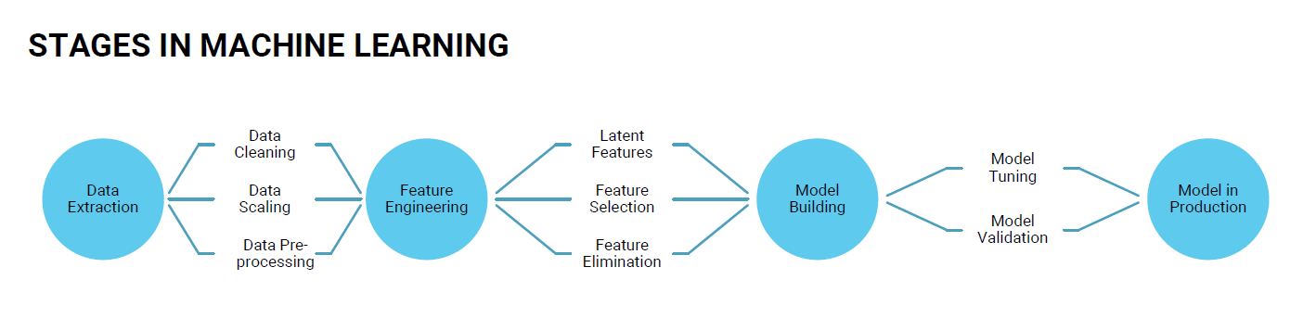
Stages in machine learning (ML)

Slide 5
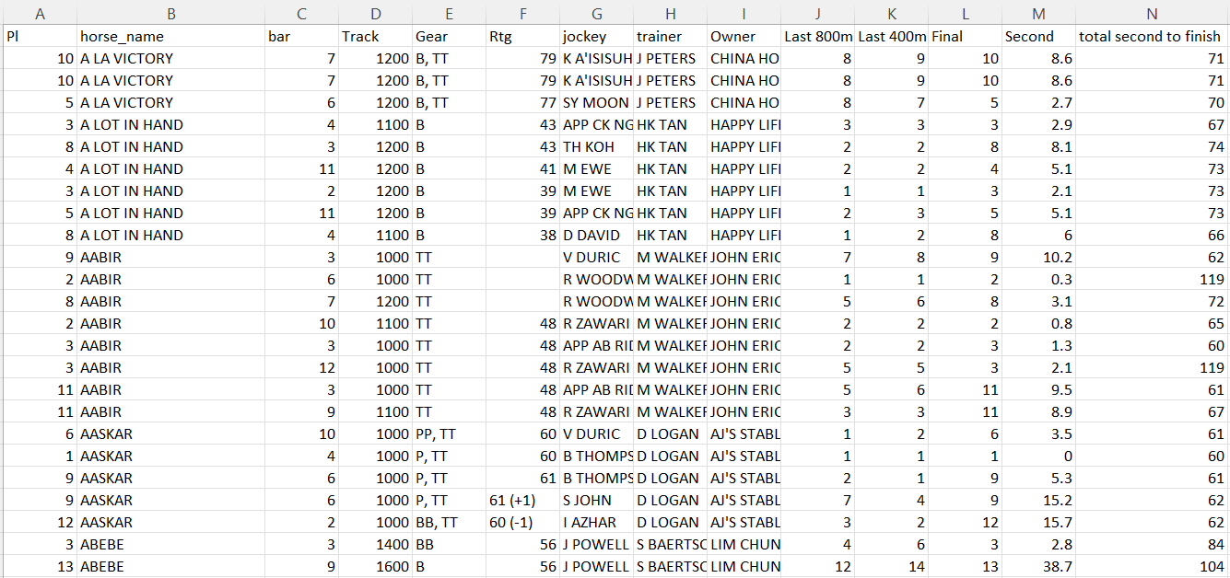
Stage 1: Data Extraction
Source of the data:
https://racing.turfclub.com.sg/ (Turf Club Home Page )
- We choose Singapore turf club as it had wide range of data available regarding about horse racing since 1992.
- We choose the date from 01 January 2017 to 31 October 2022 (6 Years) as we believe that average racehorses can run at its peak 4 to 5 years.
- Scrap the data from website using selenium
- Final output as the result of scrapping with selenium.

Slide 6
Column attributes (Features)
Total 14 Features we scrap from the Singapore Turf Club website:
Placing (Pl) – Final placing in the race
Horse Name
Bar – Gate for the horse to race
Track – Race Distance
Gear – Things like reins, whips, crops and hoods allow jockey to get the horse run faster
Rating (Rtg) – A horse assign to determine the type of the race to be compete
Jockey – Person who rides the horse in horse racing
Trainer – Person who train the horses for the racing
Owner – Person who owns the stable & the horse
Last 800m – Horse Placing for final 800m distance towards the end
Last 400m – Horse Placing for final 400m distance towards the end
Final – Final placing in the race
Second – Time different in seconds between the winner of the race
Total second to finish (time-sec) – Time to finish the race
* yellow in highlight will be selected for analysis and ML purpose.

Slide 7
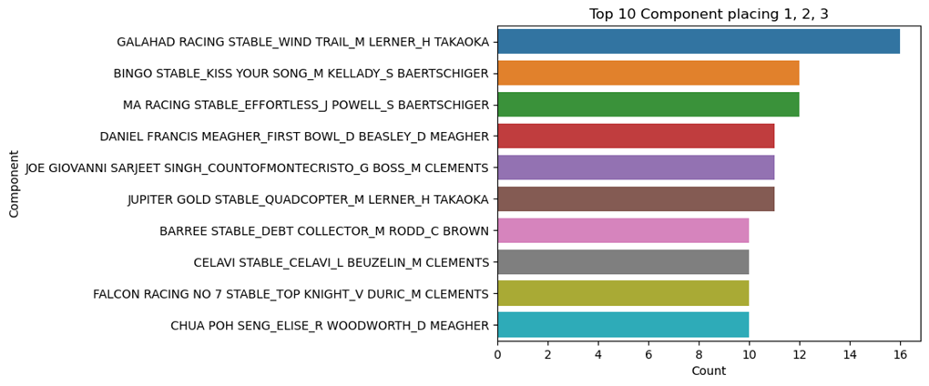









Part 1: Exploratory data analysis (EDA)
Stage 2: feature engineering
Component = Owner + Horse Name + Jockey + Trainer
From the bar chart, although the component is different where they win the top 3 places, there is some similarity between trainer.

Slide 8
Part 1: Exploratory data analysis (EDA)
Stage 2: feature engineering
Component = Owner + Horse Name + Jockey + Trainer
Relationship between 4 components:
1. Horse not only have 1 owner only as they might be trade for breeding
2. Trainer follow the horses when they change the owner.
3. Owner is correlated to trainer as they hire trainer to train the horse.
4. Jockey is the independent features that not correlated to each components as they can ride any horses during the race from different owners.

Slide 9
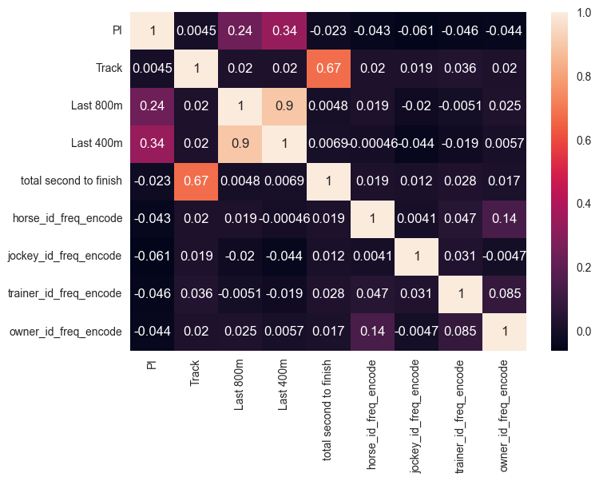
Part 1: Exploratory data analysis (EDA)
Stage 2: feature engineering
Notes:
From the correlation heatmap, there are 2 features correlated to the final placing. 1. Last 800m 2. Last 400mThe last 400m and last 800m is highly correlated between each other.Track is also correlated to total second to finish that different distance takes different timing to finish.

Slide 10
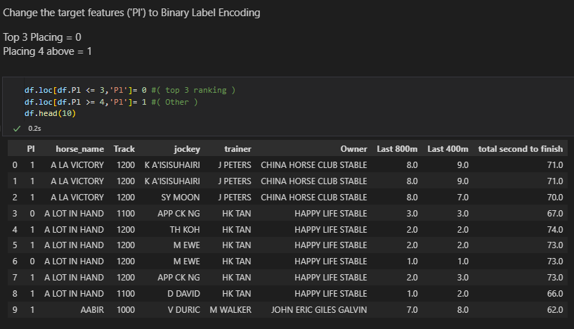
Stage 2: feature engineering
Part 2: Label Encoding
Based on the strategy spoken previous slides, target (‘Pl’) change to binary labels encoding.
Split to 2 class
Top 3 ranking ( Placing 1, 2 and 3 )
Other ( Placing after 4 )

Slide 11
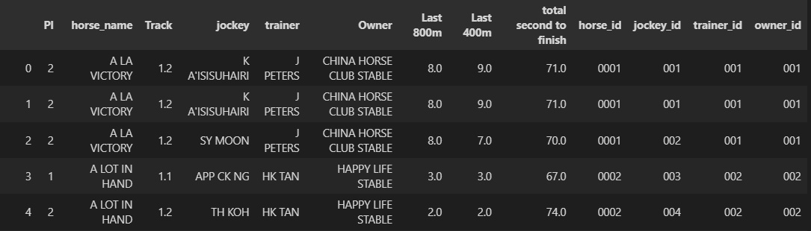



Stage 2: feature engineering
Most of algorithms cannot handle categorical variable, so we will convert the them to numeric values.
For the dataset we have 4 feature is categoric variable :
Horse name (Nominal data)
Jockey (Nominal data)
Trainer (Nominal data)
Owner (Nominal data)
This 4 feature is individual and can't compare each other, so we will use the frequency encoding method convert them to numeric value.
Step 1 – Convert them to ID (string)

Slide 12
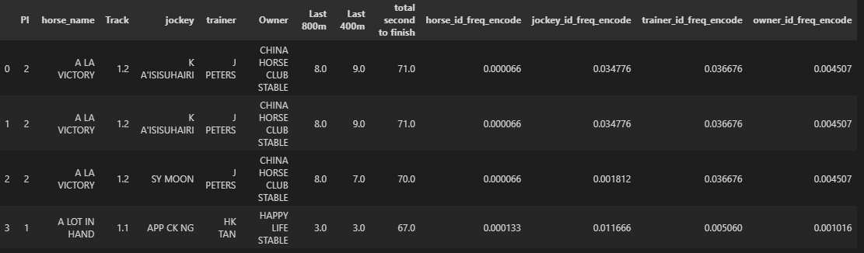
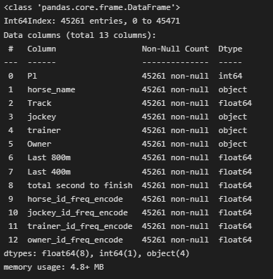






Step 2 – Convert them to numeric by using Frequency Encoding method
Beside that, minimize Track features value in order to scale the value with other features.

Slide 13
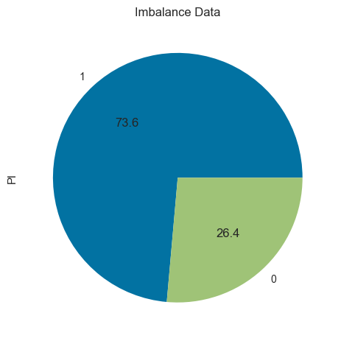
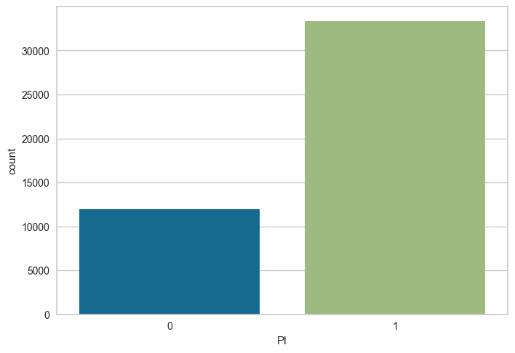
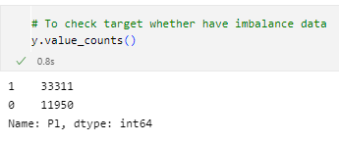
Stage 3 & 4: model building & production
STEP 1:
Before choosing which model to build, check the data whether imbalance or balance.

Slide 14
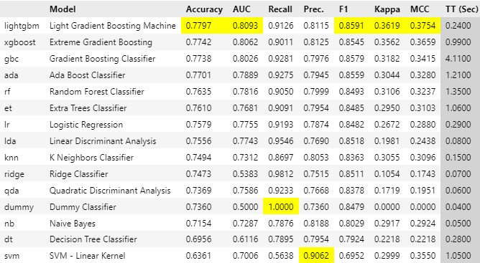
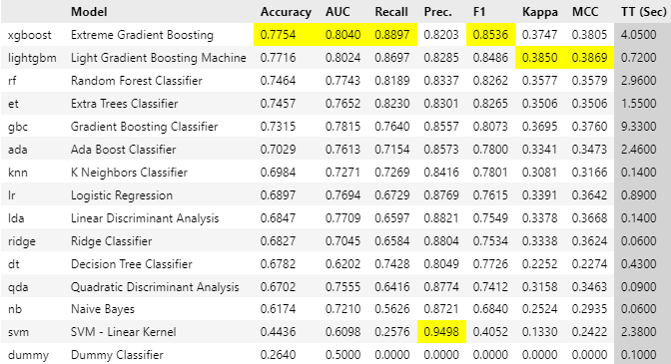
Stage 3 & 4: model building & production
STEP 2:
Known that data is imbalance. Use Pycaret to compare model selection with accuracy as the target to select model with imbalance data, fixed imbalance data method (SMOTE, RandomOverSampler (ROS) & RandomUnderSampler (RUS))
Fixed Imbalance Data SMOTE Method
Highest Accuracy: 77.54%
Imbalance Data
Highest Accuracy: 77.97%

Slide 15
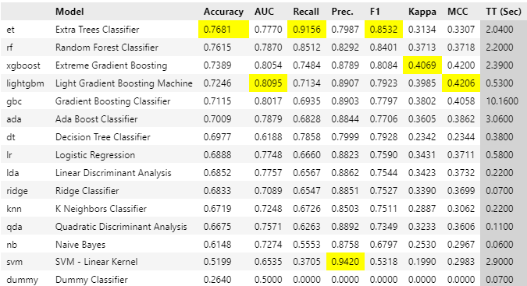
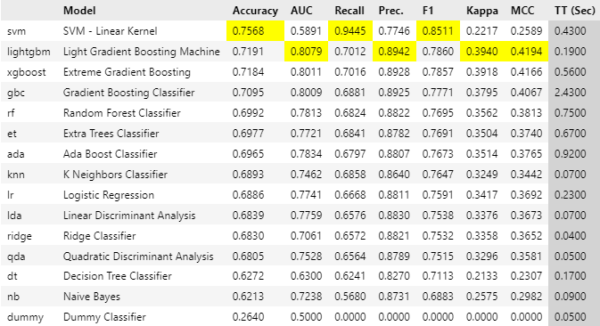
Stage 3 & 4: model building & production
STEP 2:
Fixed Imbalance Data RandomOverSampler (ROS)
Highest Accuracy: 76.81%
Fixed Imbalance Data RandomUnderSampler (RUS)
Highest Accuracy: 75.68%

Slide 16
Stage 3 & 4: model building & production
STEP 2:
Pycaret Model Selection without cross validation
Imbalance Data (Highest accuracy:77.97%)
Fixed imbalance data SMOTE (Highest accuracy: 77.54%)
Fixed imbalance data ROS (Highest accuracy: 76.81%)
Fixed imbalance data RUS (Highest accuracy: 75.68%)
SMOTE method will use to fix the imbalance data.

Slide 17
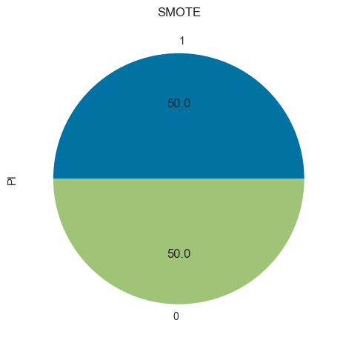
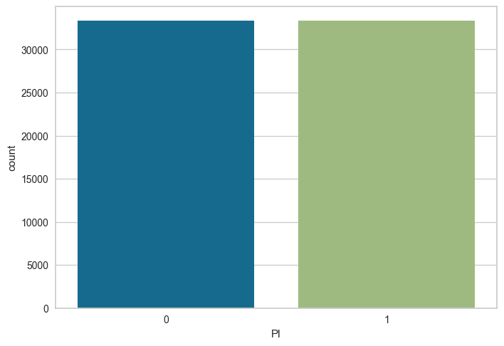
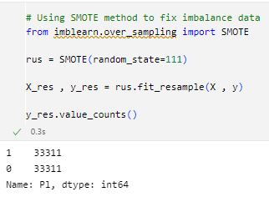
Stage 3 & 4: model building & production
STEP 3:
Fixed imbalanced data by using SMOTE method

Slide 18
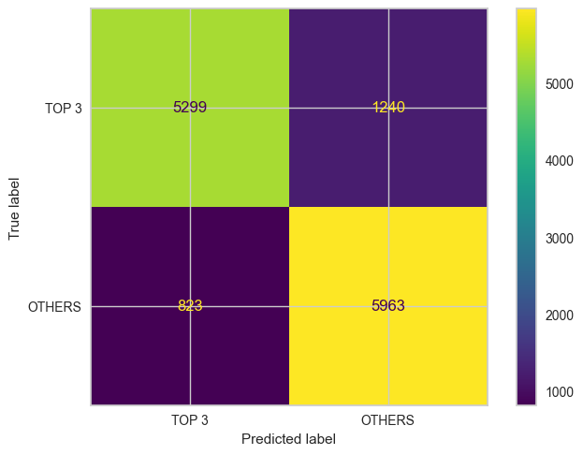
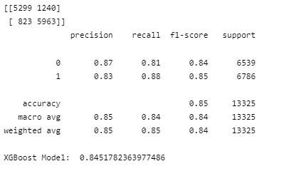
Stage 3 & 4: model building & production
STEP 4:
Hypothesis: Fixed imbalance data will give better accuracy for imbalance data.
To compare by selecting one model (xgboost) with imbalance data & fixed imbalance data (SMOTE).
Fixed Imbalance Data SMOTE Method
Confusion Matrix Plot

Slide 19
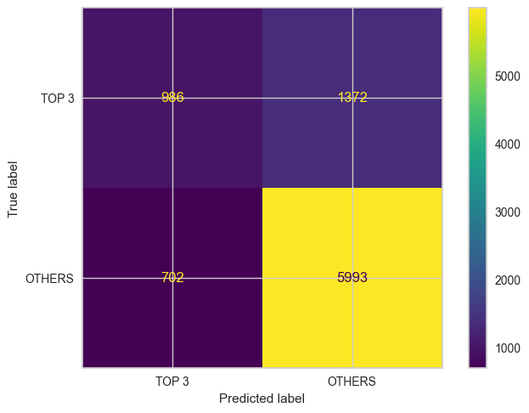
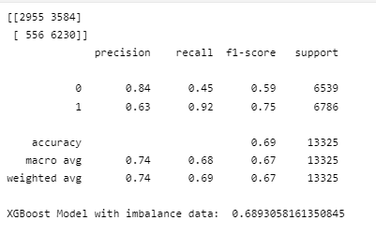
Stage 3 & 4: model building & production
STEP 4:
Hypothesis: Fixed imbalance data will give better accuracy for imbalance data.
To compare by selecting one model (xgboost) with imbalance data & fixed imbalance data (SMOTE).
Imbalance Data
Confusion Matrix Plot

Slide 20
Stage 3 & 4: model building & production
STEP 4:
Hypothesis: Fixed imbalance data will give better accuracy for imbalance data.
Hypothesis Correct!
Imbalance Data: 68.9%
Fixed Imbalance Data:84.5%
SELECT the top 5 modeling from pycaret under SMOTE method.
1. Extreme Gradient Boosting (xgboost)
2. Light Gradient Boosting (lightgbm) 3. Gradient Boosting Classifier (gbc) 4. Random Forest Classifier (rf)
5. Extra Trees Classifier (et)

Slide 21
Stage 3 & 4: model building & production
STEP 5:
Top 5 modeling from pycaret under SMOTE method
1. Extreme Gradient Boosting (xgboost)

Slide 22
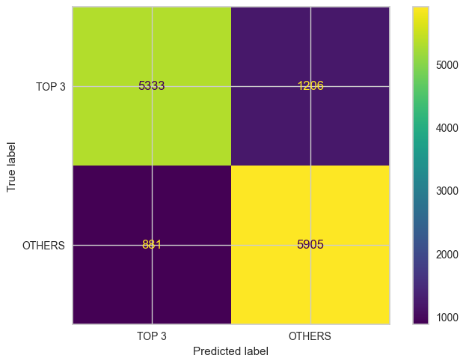
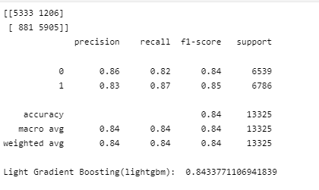
Stage 3 & 4: model building & production
STEP 5:
Top 5 modeling from pycaret under SMOTE method
2. Light Gradient Boosting (lightgbm)

Slide 23
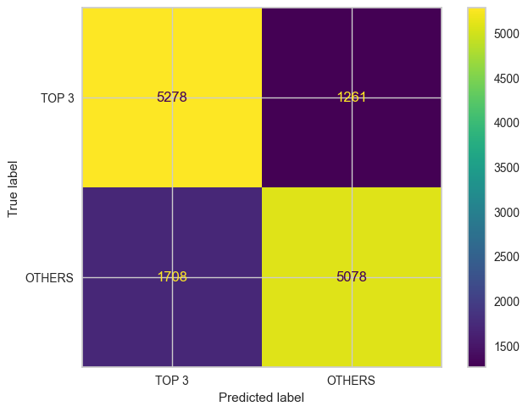
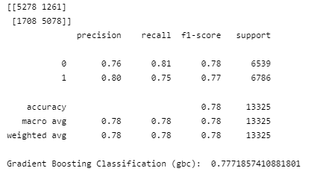
Stage 3 & 4: model building & production
STEP 5:
Top 5 modeling from pycaret under SMOTE method
3. Gradient Boosting Classifier (gbc)

Slide 24
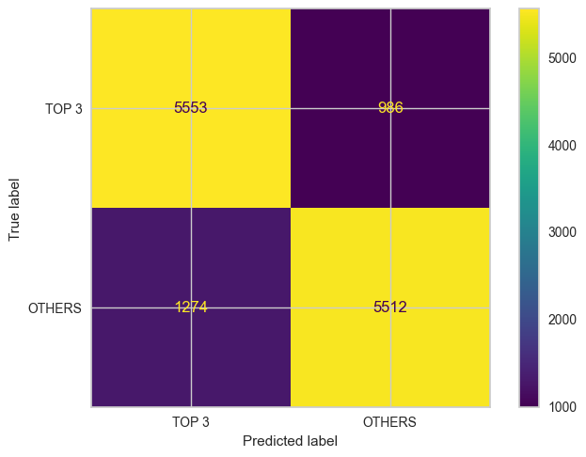
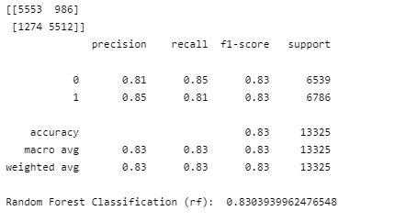
Stage 3 & 4: model building & production
STEP 5:
Top 5 modeling from pycaret under SMOTE method
4. Random Forest Classifier (rf)

Slide 25
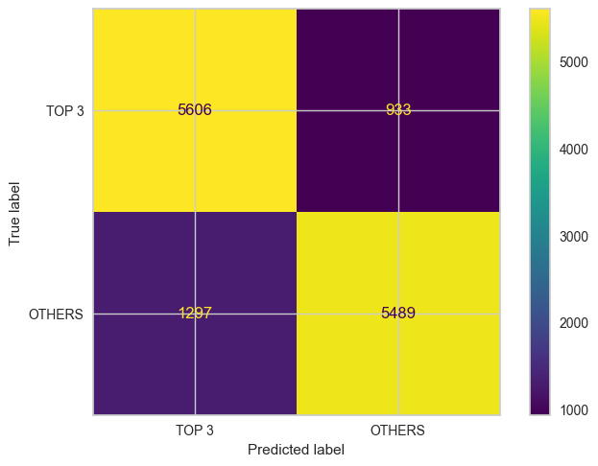
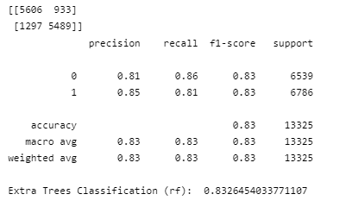
Stage 3 & 4: model building & production
STEP 5:
Top 5 modeling from pycaret under SMOTE method
5. Extra Trees Classifier (et)

Slide 26
Stage 3 & 4: model building & production
STEP 5:
Overall models accuracy using fixed imbalance data SMOTE method
1. Extreme Gradient Boosting (xgboost) – 84.5%
2. Light Gradient Boosting (lightgbm) – 84.3% 3. Gradient Boosting Classifier (gbc) – 77.7% 4. Random Forest Classifier (rf) – 83.0%
5. Extra Trees Classifier (et) – 83.3%
EXTREME GRADIENT BOOSTING (XGBOOST) selected for hyper tuning model.

Slide 27
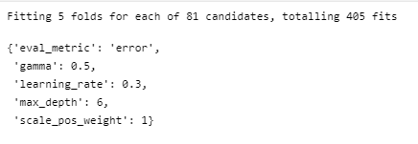
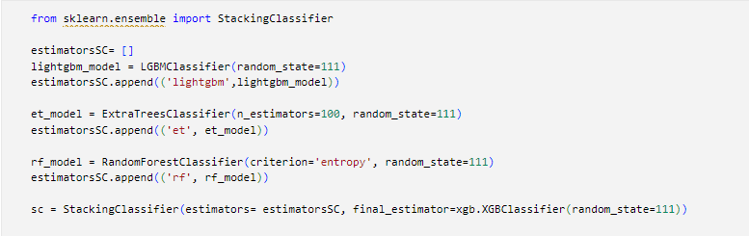
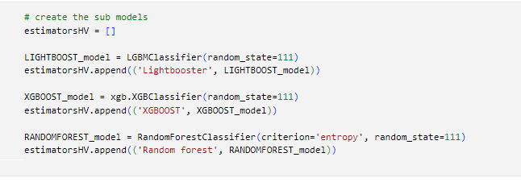
Stage 3 & 4: model building & production
STEP 5:
Compare both emsemble model (Hard Voting & Stacking Classifier) & GridSearch CV by using highest accuracy on model selection (XGboost) to see whether can improve the accuracy.
1. HardVoting Classifier – 84.9%
2. Stacking Classifier – 85.9%
3. GridSearchCV(XGBoost)- 84.7%
GridSearchCV parameters
Stacking Classifier parameters
HardVoting Classifier parameters

Slide 28
Stage 3 & 4: model building & production
STEP 6:
To check whether combine all 4 features into 1 ID or separate 4 IDs will give better accuracy.
Method:
Compare by using XGBoost with fixed imbalance data SMOTE method with accuracy.
Single ID: 77.4%
Multiple ID: 84.5%
Final model to use for horse prediction: Stacking Classifier with XGBoost with multiple ID (85.9%)

Slide 29
Challenges/Takeaway
Challenges
Although the data easy to obtain, the scraping part with selenium more complicated that took lots of time to scrap it
Data limitation – no horse profile that able to scrap it to know the horse size & its heritage
In feature 400m & 800m that has higher correlation with the final placement, we can’t place the bet as the bet only open before the race. In the end we need to rely on the final placement of the race.
Takeaway
1. Selenium is suitable to scrap for large pools of datasets.
2. Pycaret is good to use for comparing models
3. Choose suitable features in datasets to do machine learning
GitHub link:
https://github.com/evansim85/Horse-Racing-Machine-Learning
https://github.com/Ansonex/Horse-_Racing_Machine_Learning

